Slide 1
Drivers of Corporate Bond Market Liquidity in the European Union
Presentation by Risk Control
Brussels, November 2017

Slide 2
Introduction
This report on corporate bond market liquidity in the European Union was prepared for the European Commission by Risk Control.
The report aims to provide a thorough analysis of the factors that influence market liquidity in corporate bonds, both financial and non-financial.
The report considers both cyclical factors that drive liquidity and changes underway in the European corporate bond market including the development of new trading mechanisms.

Slide 3
Datasets Employed
We use the following datasets:
MiFID 1 data from the UK’s FCA provide extensive information on the time, size, venue, and counter-parties involved in individual trades and security identifiers such as the ISIN of the security in question for the period September 2011 to August 2016 with an average number of daily transactions equalling 9,190 and an average daily volume of €5.4 billion.
Bond settlement data from Euroclear reportedly covering more than 60% of the European bond market. The most substantial dataset comes from Euroclear’s ESES subsidiary and comprises data on 769,570 corporate bond transactions in the period December 2014 to August 2016.
Transactions data from a major ETP between 2010 and 2016. The number of corporate bond ISINs included in the platform was 4,125 at the end of the sample period.
Bond quote data from Bloomberg, including daily quotes (bid and ask) since 1990 for 9,400 European corporate bonds.
Bond and issuer characteristic data from the Eikon database supplied by Thomson Reuters.

Slide 4
Dataset Coverage (1/2)
Number of ISINs (ever appeared) by country

Slide 5
Dataset Coverage (2/2)
Data distribution (ever appeared) in different datasets
Data distribution (as of 2016-07-01) in different datasets

Slide 6
Activity Trends for Non-financials-FCA data
1 Mean ticket size (EUR millions)
2 Mean daily turnover (%)
3 Fraction of bonds traded
4 Mean number of daily transactions
Focussing on non-financials, again mean ticket sizes rise, and the universe of bonds traded contracts and mean number of daily transactions per ISIN falls. But turnover rates for non-financials exhibit a clearer downward trend by about a quarter over the 5 years.

Slide 7
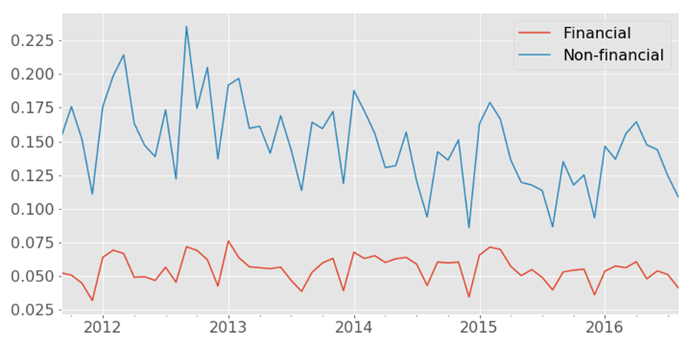
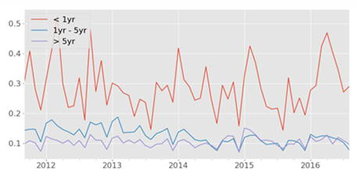
Turnover rates broken down
Mean daily turnover by age (non-financial bonds)
Mean daily turnover for financials and non-financials (all bonds)
Breaking down turnover rates, they appear reasonably flat for financials.
The main drop is in turnover rates for bonds older than a year.

Slide 8
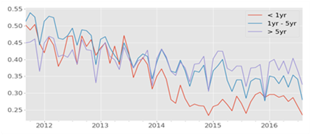
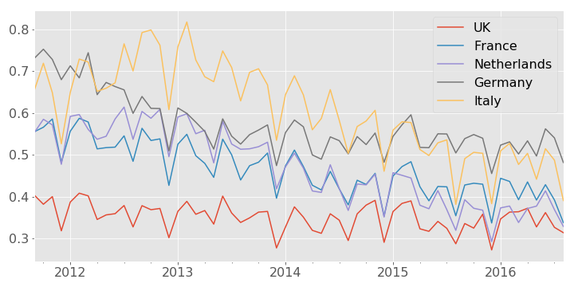
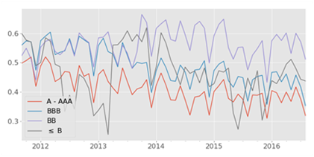
Non-financials trading daily
Fraction of bonds traded daily by maturity
Fraction of bonds traded daily by country
Fraction of bonds traded daily by rating
The fraction of bonds traded daily falls particularly for short maturity bonds and for German, Italian and French bonds, as well as for IG bonds.

Slide 9
FCA data Activity Regression Results
All bonds
Non-financials

Slide 10
Summary of Activity-based
Liquidity Indicators
FCA data suggest non-financial bond turnover rates have been falling while turnover rates for bonds overall are flat.
Mean daily turnover rates fall in the Euroclear data and fall after 2013 in the ETP data (after having risen earlier).
In the FCA data, the fraction of bonds traded declines for both financials and non-financials.
The fractions traded decrease most for shorter maturity bonds and for bonds from Italy, France and Germany.
Ticket sizes are up both in FCA, Euroclear and ETP datasets
The number of transactions trends down in the FCA data.

Slide 11
Bloomberg Spreads (1/2)
1 Spreads for all bonds in bps
2 Spreads or Financials versus Non-financials in bps
3 Spreads for bonds of different ages in bps
4 Spreads for High Yield and Investment Grade bonds in bps

Slide 12
Bloomberg Spreads (2/2)
1 Spreads for bonds of different issues size in bps
2 Spreads for bonds by currency in bps
3 Spreads for bonds by volatility buckets in bps
4 Counts by month of bonds by price volatility buckets

Slide 13
Bloomberg Spread Regressions
Period 01/1999 to 09/2016
Period 01/2010 to 09/2016

Slide 14
ETP Effective Spreads (1/2)
1 Spreads for all bonds in bps
2 Spreads for Financials versus Non-financials in bps
3 Spreads for bonds of different ages in bps
4 Spreads for High Yield and Investment Grade bonds in bps

Slide 15
ETP Effective Spreads (2/2)
1 Spreads for bonds of different issues size in bps
2 Spreads for bonds in different currencies in bps
3 Spreads for bonds bucketed by price volatility in bps
4 Counts by month of bonds in different price volatility buckets

Slide 16
ETP Spread Regressions

Slide 17
Price-impact measures
1 Amihud Ratio v2 for all bonds
2 Amihud Ratio v2 for Financials versus Non-financials
3 Amihud Ratio v2 for bonds of different ages
4 Amihud Ratio v2 for High Yield and Investment Grade bonds

Slide 18
Round Trip Liquidity Indicators
1 IRTC for all bond
2 IRTC for Financials versus Non-financials
3 IRTC for bonds of different ages
4 IRTC for High Yield and Investment Grade bonds

Slide 19
Summary of Price-based
Liquidity Indicators
Bloomberg spreads rise to largest peak in 2011 with much smaller peak in 2008. Spreads post 2014 rise. Current levels are higher than 2008.
Clear, age, fin vs non-fin, issue size, IG vs IG and GBP vs EUR effects.
Conditional on volatility buckets, Bloomberg spreads show little recovery post-crisis.
ETP spreads show 2010 peak (start of data) followed by higher 2011-12 peak. Again, clear and intuitive category effects.
Volatility-bucketed ETP spreads much flatter than non-bucketed but still show rise post 2014.
Price impact (Amihud ratio) measures show u-shape signalling post 2014 deterioration to levels similar to those of 2011 crisis.
Round trip measures show lop-sided u-shape with high crisis peak and partial return to high levels (especially for HY and non-financials) post 2014.

Slide 20
Dealer Profitability (1/2)
We examine the issue of dealer profitability indirectly by studying proxy measures.
  Exact round trip returns from trading immunised for interest rate changes and hedging.
  Dealer inventories. The evolution of inventories reflects how profitable it is for banks to commit capital to dealing operations.
  Carry return of holding bonds net of financing costs. The financing costs reflect the funding costs faced by the bank plus managerial adjustments that bank treasury operations use to drive the balance sheets of their institutions.
In each case, we calculate and evaluate possible candidate profitability drivers.

Slide 21
Dealer Profitability (2/2)
What are the potential pressures on dealer profitability that would affect market-making profitability?
During the period we study, major changes occurred in the regulatory environment that European bond market-makers face. The changes include the introduction of Basel 3 measures for bank capital, leverage and liquidity rules, and alterations in securities markets regulations.
The period we examine also contains the aftermath of one crisis (the 2007-8 subprime collapse culminating in the failure of Lehman Brothers) and the occurrence of a second major crisis: the 2011-12 European sovereign debt crisis which brought with it concerns about the durability of the Eurozone itself. These shocks to the market environment clearly affected dealer profitability considerably.
Other potential pressures on dealer profitability include the low interest rate environment that has prevailed in Europe since 2012 and, possibly, changes in the competitive environment.

Slide 22
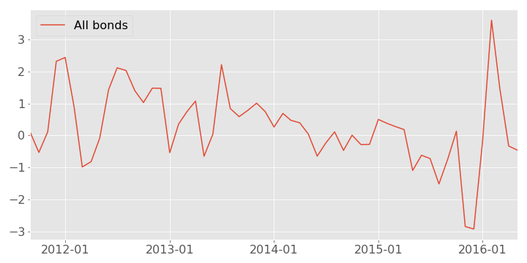
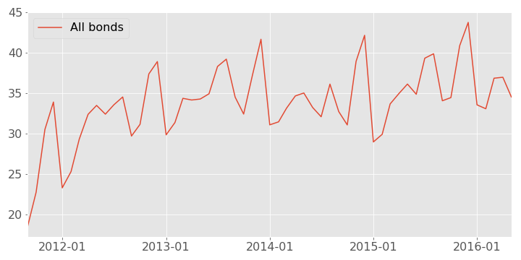
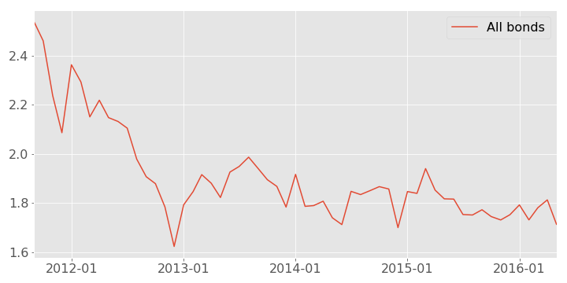
Exact Round Trip Measures
Return on round trip (%, IR immunised, net of funding cost)
We estimate round trip measures using a more elaborate methodology than the simplified IRTC approach shown above.
This involves tracking individual bank purchases and sales to calculate true round trip measures and then immunising against interest rate changes.
Average number of days for roundtrip
Average number of trades to complete roundtrip

Slide 23
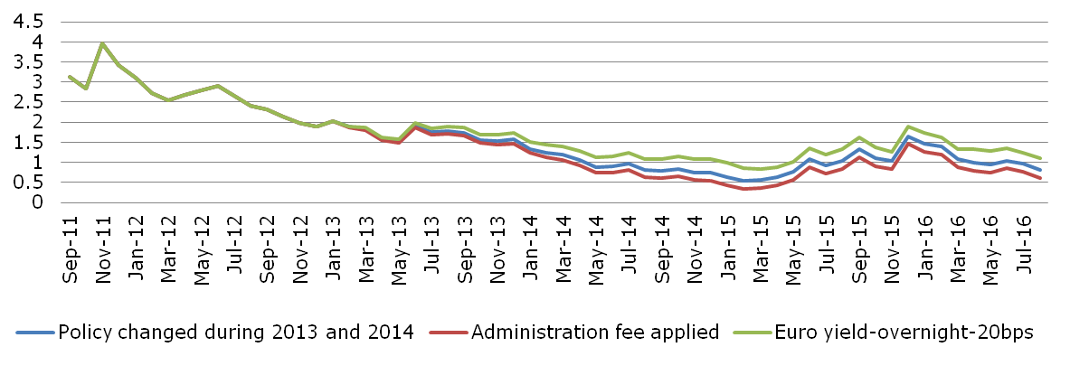
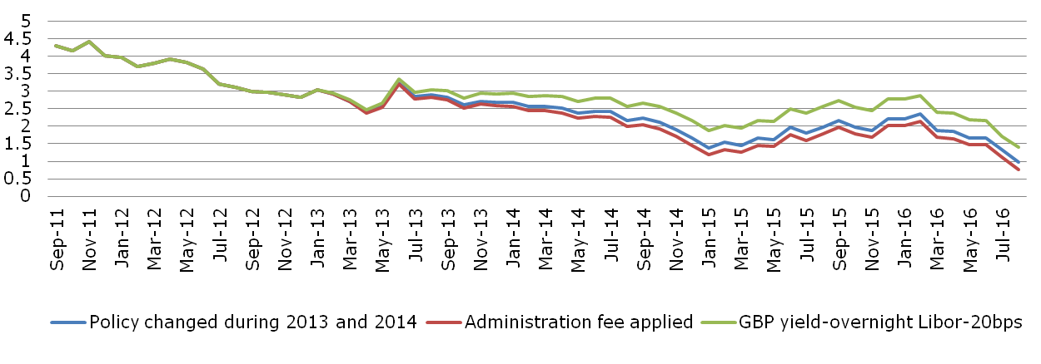
Carry Spreads with Policy Changes
EUR-denominated bonds
We estimate the weighted average yields of data in the FCA dataset and calculate the spread over funding costs under different assumptions about how bank treasuries charge for dealer funding.
GBP-denominated bonds
My

Slide 24
Regression of Round Trip Return
Adjusted for Funding Cost and Hedging

Slide 25
Summary on Dealer Profitability
It is difficult from these events to see a completely clear picture in which particular events generated unambiguous outcomes for corporate bond market liquidity.
Corporate bond market-making is a flow business in which participants’ perceptions of changes in viability of activities takes time to accumulate.
In this case, the cumulative impact of different changes in the regulatory and market environment could impair liquidity in a gradual way.

Slide 26
Conclusion (1/4)
Our empirical analysis points to recent declines in key activity indicators such as turnover rates and the fractions of bonds that do not trade at all.
We also show that, since 2014, price-based indicators of liquidity (such as effective and bid-ask spreads, round trip and market depth measures) have deteriorated markedly.
When price-based measures of liquidity are adjusted for risk, the sharp rise in transactions costs that occurred in the 2011 crisis appears never to have been reversed.
These empirical findings suggest the existence of a “liquidity problem” in European corporate bonds.

Slide 27
Conclusion (2/4)
Attributing this “problem” to specific sources is challenging.
One possible cause is regulatory changes placing pressure on market-maker profitability.
Profitability is hard to observe directly but one may look at such proxies as round trip returns, dealer inventories and carry spreads over funding costs.
Round trip returns trend down, dealer inventories of corporate bonds fell sharply in 2011 and early 2012, carry spreads (between bond yields and funding costs) appear to have drifted down between mid-2012 and early 2015.
Can one relate these developments to regulatory changes?

Slide 28
Conclusion (3/4)
The main regulatory pressures on profitability are capital and liquidity rules.
The Basel 2.5 market risk capital rules are risk-insensitive and appear close to flat through the period in which we are interested.
On liquidity, EBA QIS data suggest that European banks made efforts to be compliant with Basel 3 LCR and NSFR requirements between 2011 and 2014.
These efforts affected carry spreads in that European banks (i) switched their dealing desks to financing positions with 1 year rather than overnight funding and (ii) in some cases increased managerial premiums between the cost of external funds and what was charged to dealers.

Slide 29
Conclusion (4/4)
One may question whether “the timing is right”.
Bank compliance with liquidity rules was largely complete by 2015 whereas price-based illiquidity indicators rose after 2014 and quantity-based indicators deteriorated over a longer period.
Obscuring connections between cause and effect is the fact that bond market-making is a flow business in which profitability changes may lead participants only gradually to follow strategies that involve supplying more or less liquidity.
Even if liquidity supply had been reduced by regulatory changes, it remains a matter of judgment as to whether this is justified by reduced risk in the banking system.

Slide 30
Website: www.riskcontrollimited.com
Telephone: +44 20 3307 0730
Address: 13-14 Dean Street, London, W1D 3RS, U.K.

